Slide 1


Ganesh Maharaj Kamatham
01/01/2025

Slide 2

Outline
Executive Summary
Introduction
Methodology
Results
Conclusion
Appendix

Slide 3
Executive Summary
This project aimed to predict the success of Falcon 9 first-stage landings using data science and machine learning techniques. The methodologies involved collecting data from the SpaceX REST API and web scraping Wikipedia for historical Falcon 9 launch records. The dataset was cleaned, filtered to focus on Falcon 9 launches, and preprocessed to handle missing values and engineer new features, including one-hot encoding for categorical variables. Exploratory Data Analysis (EDA) was performed using Matplotlib, Seaborn, and SQL to identify correlations between features like payload mass, launch site, orbit type, and landing success. SQL queries provided insights into the highest payloads carried, success metrics, and the earliest ground pad landings. Machine learning models, including Logistic Regression, Support Vector Machine (SVM), Decision Tree, and K-Nearest Neighbors (KNN), were trained and evaluated using GridSearchCV for hyperparameter tuning. The SVM model emerged as the best-performing model with an accuracy of approximately 88% on the test data.
The results highlighted that Kennedy Space Center (KSC LC-39A) had the highest success rate of approximately 77%, and Low Earth Orbit (LEO) showed the most consistent success across launches. Larger payloads above 10,000 kg demonstrated a 100% success rate in specific cases. Yearly trends revealed that Falcon 9 success rates improved significantly post-2013 due to advancements in technology and reusability. Interactive visualizations using Folium mapped launch sites near coastlines and critical infrastructure, while the Plotly Dash Dashboard allowed real-time analysis of launch outcomes by site, payload range, and orbit type. Overall, the project successfully demonstrated that machine learning can predict Falcon 9 first-stage landings, potentially supporting cost optimization and decision-making for future launches.

Slide 4
Introduction
Project Background and Context
SpaceX’s Innovation in Reusable Rockets
Importance of Landing Success
Data-Driven Approach to Prediction
Using machine learning, we aim to predict landing success based on historical launch data, improving decision-making and operational efficiency for SpaceX.
Impact on the Aerospace Industry
A reliable model for predicting landing success could enhance the viability of future missions, reduce uncertainty, and contribute to making space travel more affordable.
Problems to find answers
Can we accurately predict if the first stage of the Falcon 9 will land successfully?
Can machine learning models, such as Logistic Regression, Support Vector Machines, Decision Trees, and K-Nearest Neighbors, be used effectively to classify the landing outcome?
Space Y tasks us to train a machine learning model to predict successful Stage 1 recovery

Slide 5

Section 1

Slide 6
Methodology
Executive Summary
Data collection methodology:
Combined data from SpaceX public API and SpaceX Wikipedia page
Perform data wrangling
Classifying true landings as successful or unsuccessful
Perform exploratory data analysis (EDA) using visualization and SQL
Perform interactive visual analytics using Folium and Plotly Dash
Perform predictive analysis using classification models
Tuned models using GridSearchCV

Slide 7
Data Collection
Data collection process involved a combination of API requests from Space X public API and web scraping data from a table in Space X’s Wikipedia entry.
The next slide will show the flowchart of data collection from API and the one after will show the flowchart of data collection from webscraping.
Space X API Data Columns:
FlightNumber, Date, BoosterVersion, PayloadMass, Orbit, LaunchSite, Outcome, Flights, GridFins,
Reused, Legs, LandingPad, Block, ReusedCount, Serial, Longitude, Latitude
Wikipedia Webscrape Data Columns:
Flight No., Launch site, Payload, PayloadMass, Orbit, Customer, Launch outcome, Version Booster, Booster landing, Date, Time

Slide 8
Data Collection – SpaceX API
Request (SpaceX APIs)
JSON file + Lists
Json_normalize to DataFrame from JSON
Key Phases of Data Collection
API Endpoint Selection
Data Fetching
Data Wrangling
Data Storage
GITHUB URL :
https://github.com/GANESH-MAHARAJ/Applied-DataScience-Capstone/blob/main/01-dataCollectionAndWrangling/01-jupyter-labs-spacex-data-collection-api.ipynb
Filter Data to only include Falcon 9 Launches
Cast Dictionary to a DataFrame
Dictionary relevent data
Imputate missing PayloadMass Values with mean

Slide 9
Data Collection - Scraping
Request Wikipedia HTML
BeautifulSoup
Html5lib Parser
Find launch info html table
Key Phases of Data Collection
Identify Target Web pages
Use Scraping Tools
Extract Specific Information
Data Wrangling
Data Storage
GITHUB URL :
https://github.com/GANESH-MAHARAJ/Applied-DataScience-Capstone/blob/main/01-dataCollectionAndWrangling/02-jupyter-labs-webscraping.ipynb
Cast dictionary to DataFrame
Iterate through table cells to extract data to dictionary
Create dictionary

Slide 10
Data Wrangling
Data Collection
Create a training label with landing outcomes where successful = 1 & failure = 0.
Outcome column has two components: ‘Mission Outcome’ ‘Landing Location’
New training label column ‘class’ with a value of 1 if ‘Mission Outcome’ is True and 0 otherwise.
Value Mapping:
True ASDS, True RTLS, & True Ocean – set to -> 1
None None, False ASDS, None ASDS, False Ocean, False RTLS – set
to -> 0
GITHUB URL :
https://github.com/GANESH-MAHARAJ/Applied-DataScience-Capstone/blob/main/01-dataCollectionAndWrangling/03-labs-jupyter-spacex-Data%20wrangling.ipynb
Cleaning
Handling Missing Values
Feature Engineering
Data Splitting

Slide 11
EDA with Data Visualization
Exploratory Data Analysis performed on variables Flight Number, Payload Mass, Launch Site, Orbit, Class and Year.
Plots Used:
Flight Number vs. Payload Mass, Flight Number vs. Launch Site, Payload Mass vs. Launch Site, Orbit vs. SuccessRate, Flight Number vs. Orbit, Payload vs Orbit, and Success Yearly Trend
Scatter plots, line charts, and bar plots were used to compare relationships between variables to decide if a relationship exists so that they could be used in training the machine learning model
GITHUB URL :
https://github.com/GANESH-MAHARAJ/Applied-DataScience-Capstone/blob/main/02-EDA_using_SQL_Pandas_sns/02-edadataviz.ipynb

Slide 12
EDA with SQL
Loaded data set into IBM DB2 Database.
Queried using SQL Python integration.
Queries were made to get a better understanding of the dataset.
Queried information about launch site names, mission outcomes, various pay load sizes of customers and booster versions, and landing outcomes
GITHUB URL :
https://github.com/GANESH-MAHARAJ/Applied-DataScience-Capstone/blob/main/02-EDA_using_SQL_Pandas_sns/01-jupyter-labs-eda-sql-coursera_sqllite.ipynb

Slide 13
Build an Interactive Map with Folium
Folium maps mark Launch Sites, successful and unsuccessful landings, and a proximity example to key locations: Railway, Highway, Coast, and City.
This allows us to understand why launch sites may be located where they are. Also visualizes successful landings relative to location.
GITHUB URL :
https://github.com/GANESH-MAHARAJ/Applied-DataScience-Capstone/blob/main/03-InteractiveAnalytics-Dashboard/01-lab_jupyter_launch_site_location_folium.ipynb

Slide 14
Build a Dashboard with Plotly Dash
Dashboard includes a pie chart and a scatter plot.
Pie chart can be selected to show distribution of successful landings across all launch sites and can be selected to show individual launch site success rates.
Scatter plot takes two inputs: All sites or individual site and payload mass on a slider between 0 and 10000 kg.
The pie chart is used to visualize launch site success rate.
The scatter plot can help us see how success varies across launch sites, payload mass, and booster version category.
GITHUB URL :
https://github.com/GANESH-MAHARAJ/Applied-DataScience-Capstone/blob/main/03-InteractiveAnalytics-Dashboard/02-spacex_dash_app.py

Slide 15
Predictive Analysis (Classification)
Split label column 'Class' from dataset
Fit and Transform Features using StandardScalar
train_test_split
The predictive analysis involved building, evaluating, and improving multiple classification models to predict Falcon 9 first-stage landing success. The process began with feature engineering to prepare the dataset, followed by splitting the data into training (80%) and testing (20%) subsets. Four classification models were tested: Logistic Regression, Support Vector Machine (SVM), Decision Tree, and K-Nearest Neighbors (KNN).
GITHUB URL :
https://github.com/GANESH-MAHARAJ/Applied-DataScience-Capstone/blob/main/04-Predictive-Model/SpaceX_Machine%20Learning%20Prediction_Part_5.ipynb
Score models on split test set
Use GridSearchCV on all models
GridSearchCV
(cv=10)
To find Optimal Parametres
Confusion Matrix for all Models
Compare scores of models

Slide 16
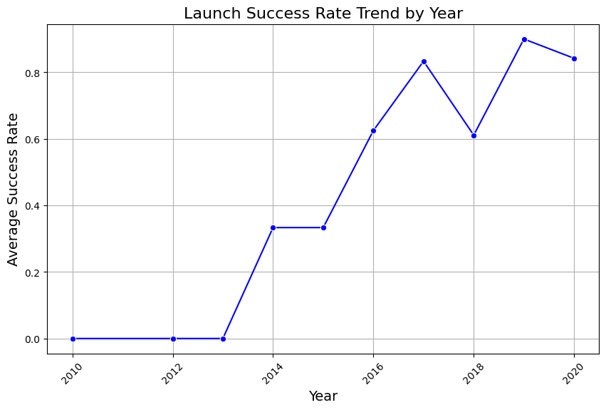
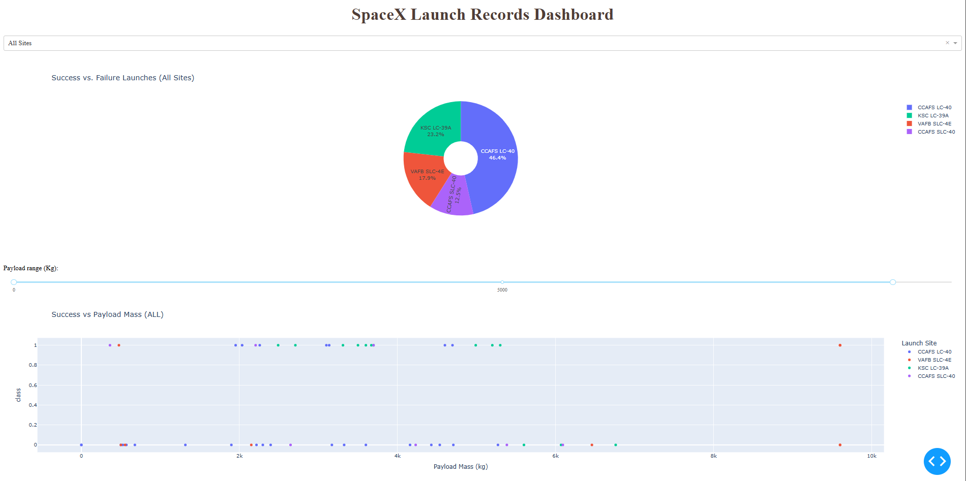
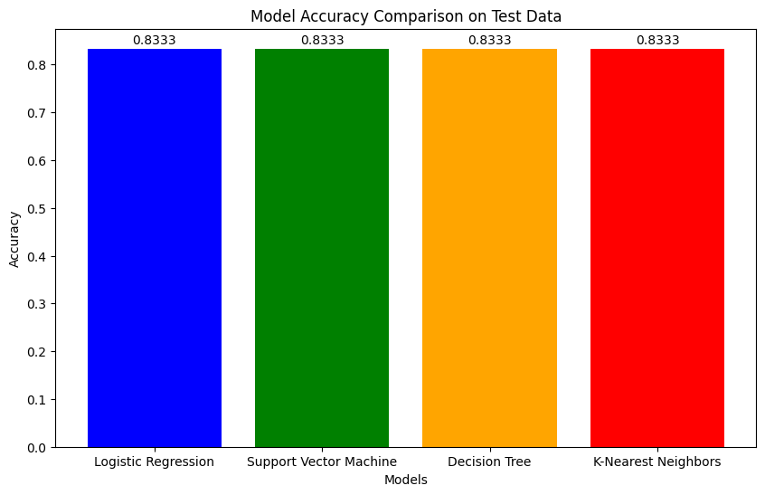
Results
Exploratory data analysis results
Interactive analytics demo in screenshots
Predictive analysis results

Slide 17

Section 2

Slide 18
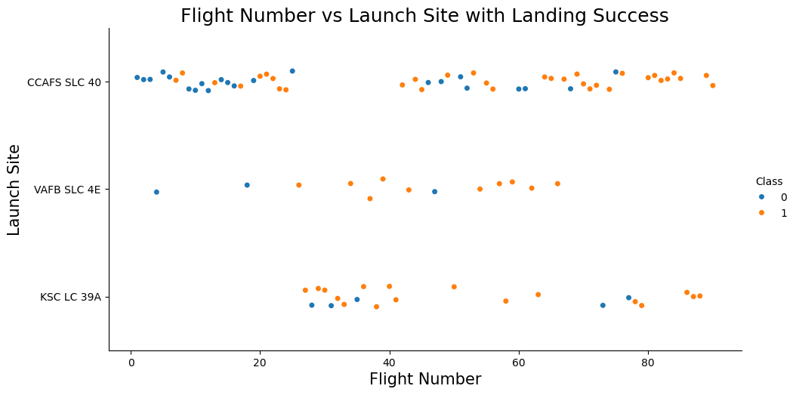
Flight Number vs. Launch Site
Graphic suggests an increase in success rate over time (indicated in Flight Number). Likely a big breakthrough around flight 20 which significantly increased success rate. CCAFS appears to be the main launch site as it has the most volume.

Slide 19
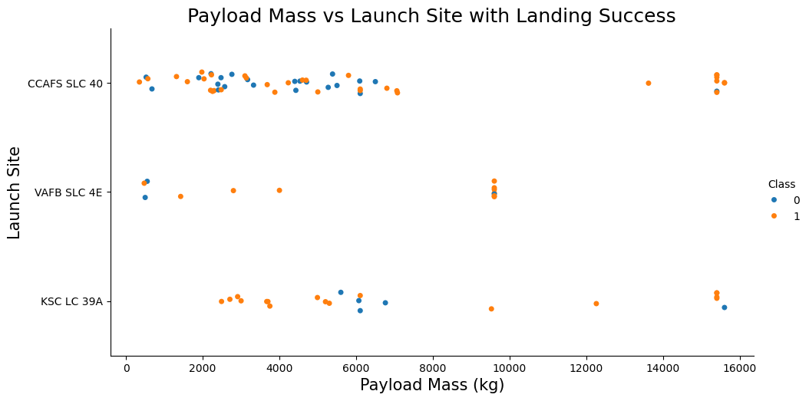
Payload vs. Launch Site
Payload mass appears to fall mostly between 0-6000 kg. Different launch sites also seem to use different payload mass.

Slide 20
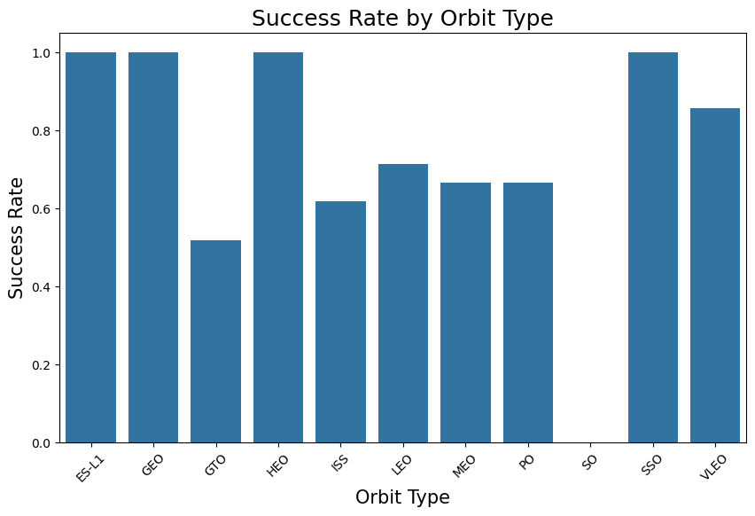
Success Rate vs. Orbit Type
ES-L1 (1), GEO (1), HEO (1) have 100% success rate (sample sizes in parenthesis) SSO (5) has 100% success rate
VLEO (14) has decent success rate and attempts
SO (1) has 0% success rate
GTO (27) has the around 50% success rate but largest sample

Slide 21
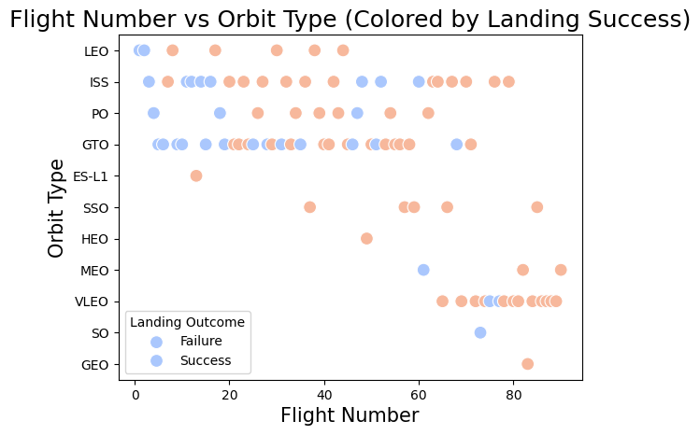
Flight Number vs. Orbit Type
Launch Orbit preferences changed over Flight Number. Launch Outcome seems to correlate with this preference.
SpaceX started with LEO orbits which saw moderate success LEO and returned to VLEO in recent launches SpaceX appears to perform better in lower orbits or Sun-synchronous orbits

Slide 22
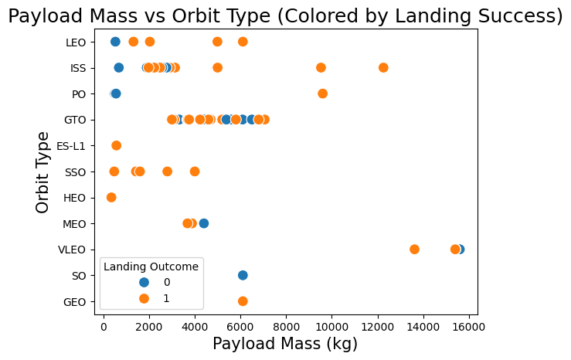
Payload vs. Orbit Type
Payload mass seems to correlate with orbit
LEO and SSO seem to have relatively low payload mass
The other most successful orbit VLEO only has payload mass values in the higher end of the range

Slide 23
Launch Success Yearly Trend
Success generally increases over time since 2013 with a slight dip in 2018
Success in recent years at around 80%

Slide 24
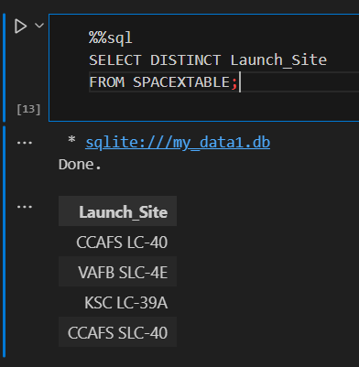
All Launch Site Names
Query unique launch site names from database.
CCAFS SLC-40 and CCAFSSLC-40 likely all represent the same launch site with data entry errors.
CCAFS LC-40 was the previous name.
Likely only 3 unique launch_site values:
CCAFS SLC-40, KSC LC-39A, VAFB SLC-4E

Slide 25
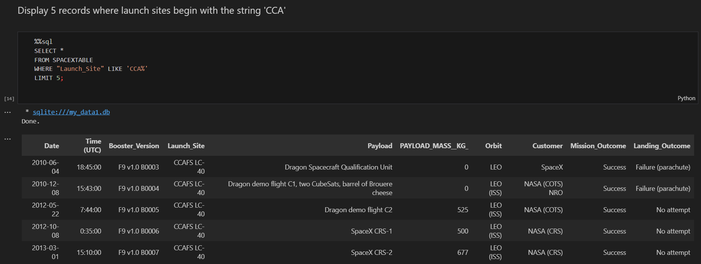
Launch Site Names Begin with 'CCA'
First five entries in database with Launch Site name beginning with CCA.

Slide 26
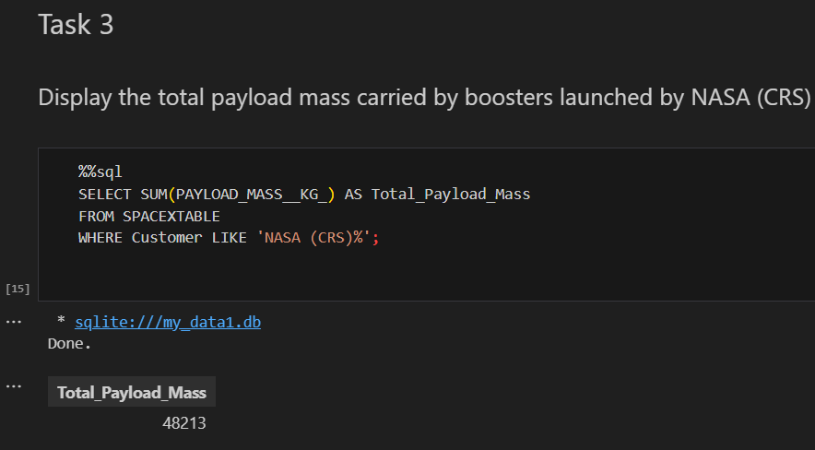
Total Payload Mass
This query sums the total payload mass in kg where NASA was the customer.
CRS stands for Commercial Resupply Services which indicates that these payloads were sent to the International Space Station (ISS).

Slide 27
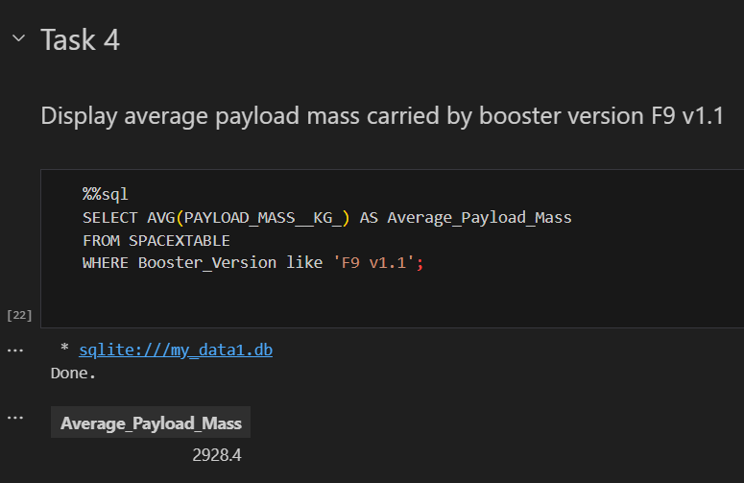
Average Payload Mass by F9 v1.1
This query calculates the average payload mass or launches which used booster version F9 v1.1
Average payload mass of F9 1.1 is on the low end of our payload mass range

Slide 28
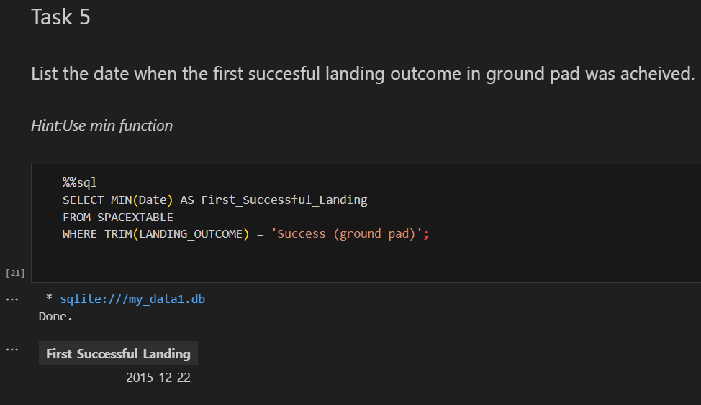
First Successful Ground Landing Date
This query returns the first successful ground pad landing date.
First ground pad landing wasn’t until the end of 2015.
Successful landings in general appear starting 2014.

Slide 29
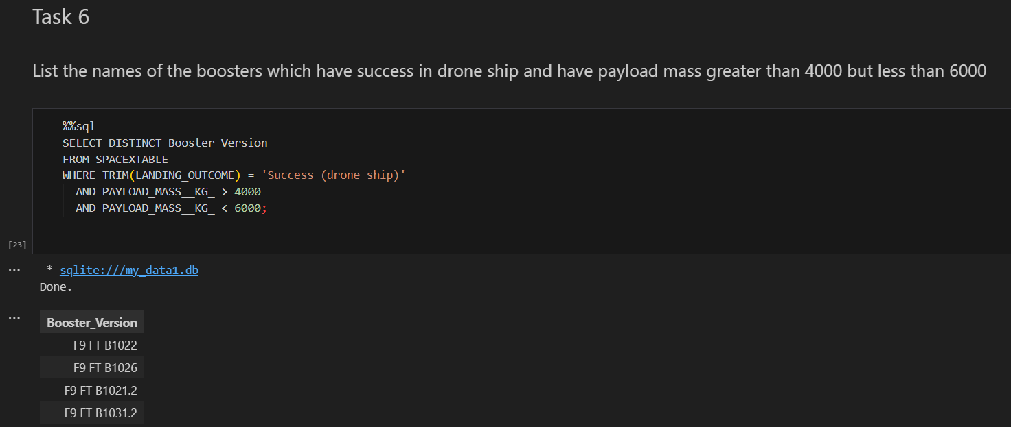
Successful Drone Ship Landing with Payload between 4000 and 6000
This query returns the four booster versions that had successful drone ship landings and a payload mass between 4000 and 6000 noninclusively.

Slide 30
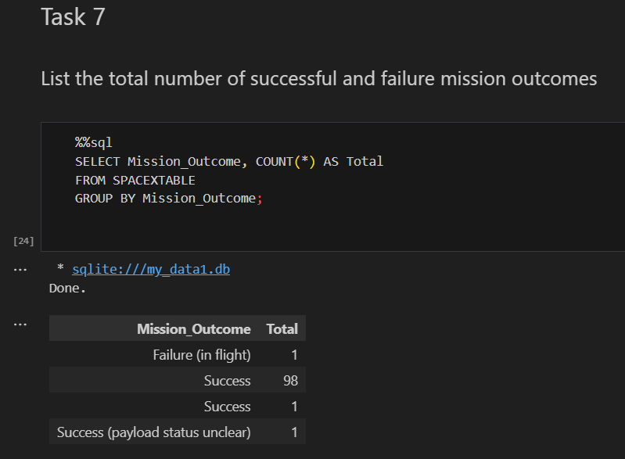
Total Number of Successful and Failure Mission Outcomes
This query returns a count of each
mission outcome.
SpaceX appears to achieve its mission outcome nearly 99% of the time.
This means that most of the landing failures are intended.
Interestingly, one launch has an unclear payload status and unfortunately one failed in flight.

Slide 31
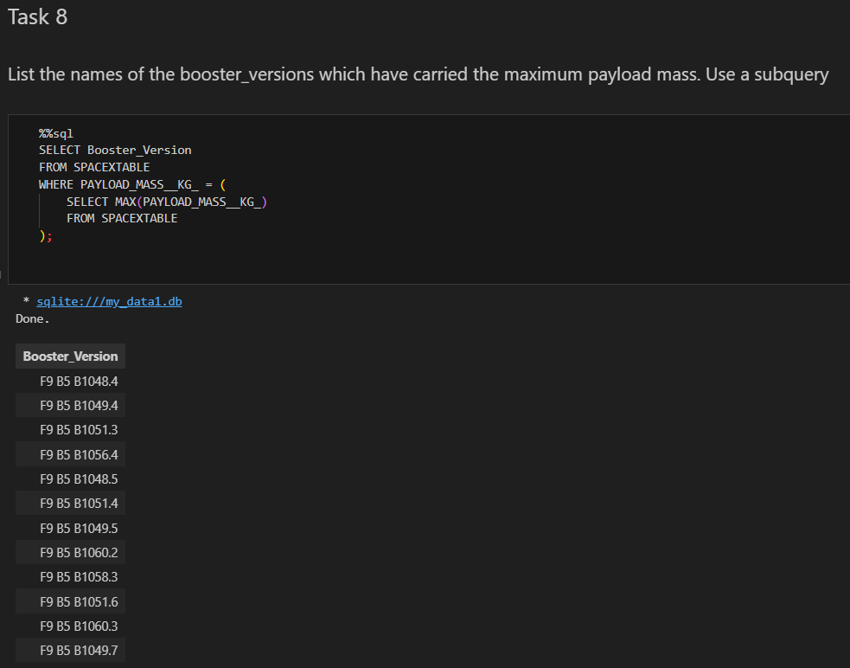
Boosters Carried Maximum Payload
This query returns the booster versions that carried the highest payload mass of 15600 kg.
These booster versions are very similar and all are of the F9 B5 B10xx.x variety.
This likely indicates payload mass correlates with the booster version that is used.

Slide 32
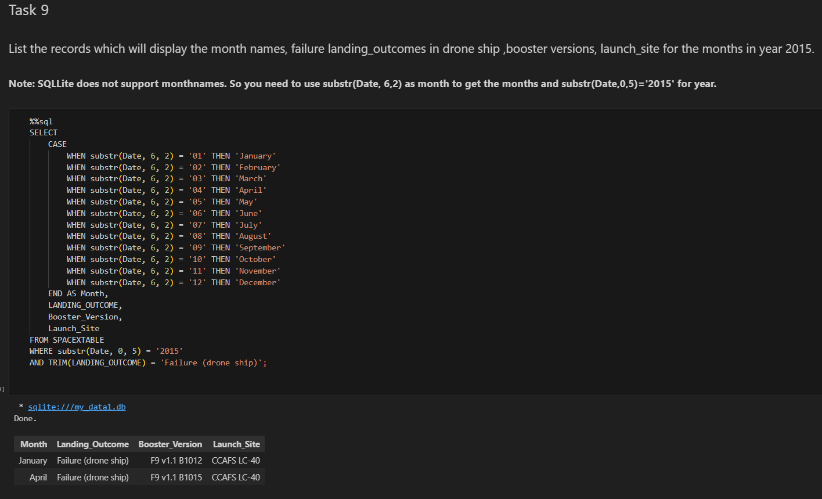
2015 Launch Records
This query returns the Month, Landing Outcome, Booster Version and Launch site of 2015 launches where stage 1 failed to land on a drone ship.
There were two such occurrences.

Slide 33
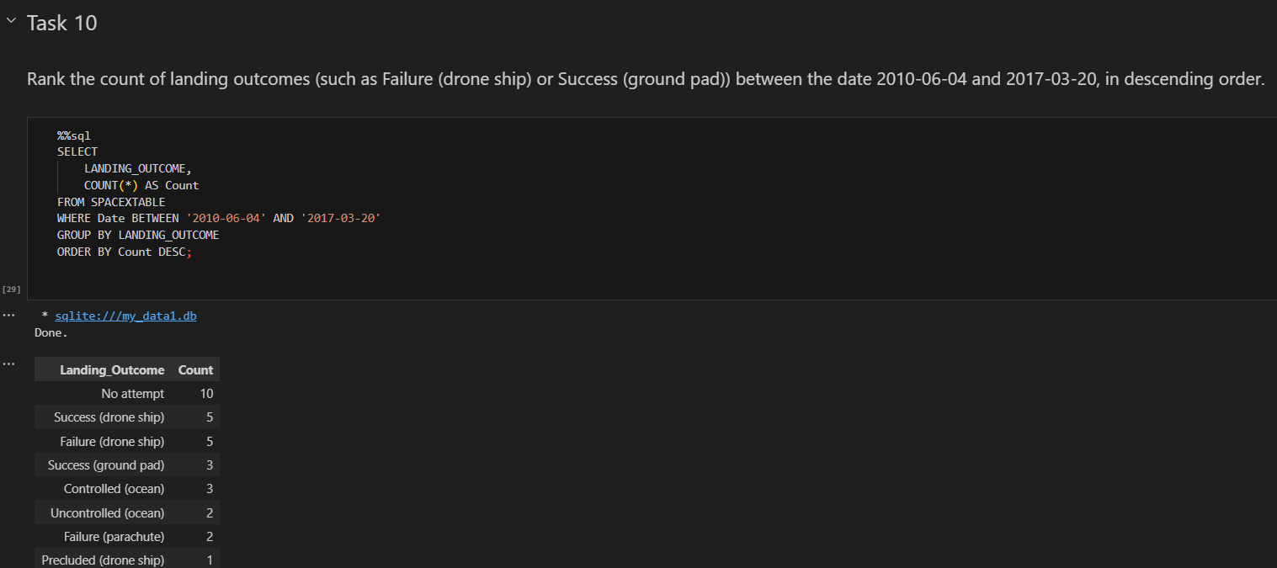
Rank Landing Outcomes Between 2010-06-04 and 2017-03-20
This query returns a list of successful landings and between 2010-06-04 and 2017-03-20 inclusively.
There are different types of landing outcomes

Slide 34

Section 3

Slide 35
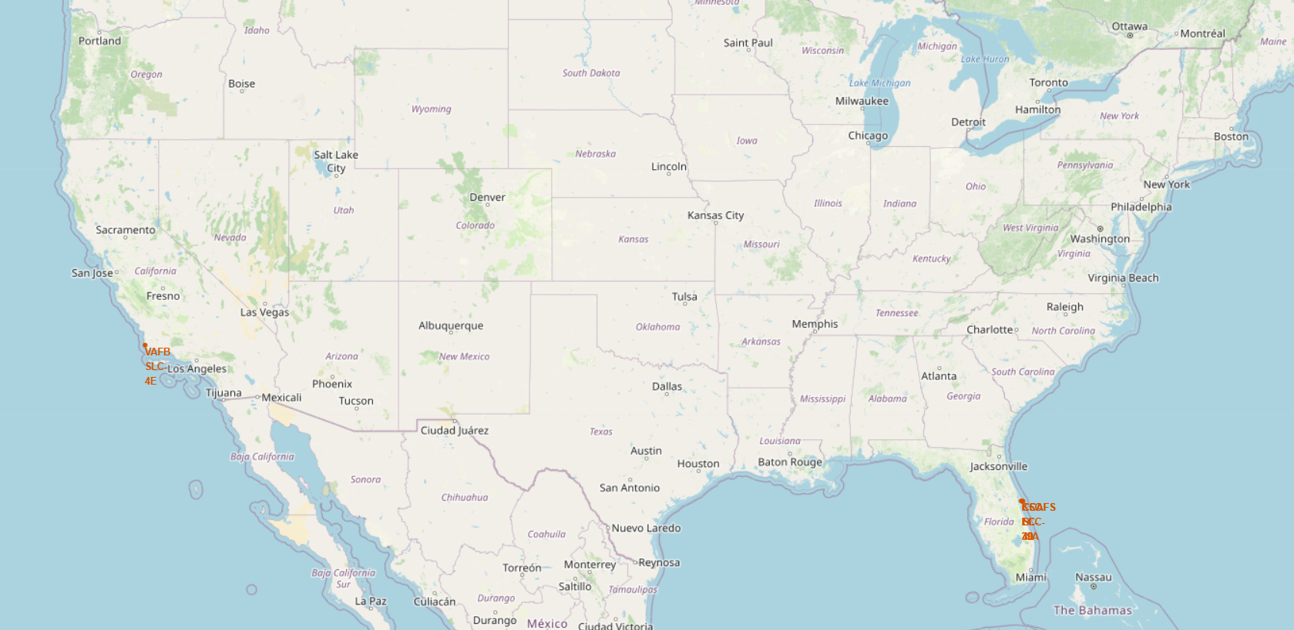
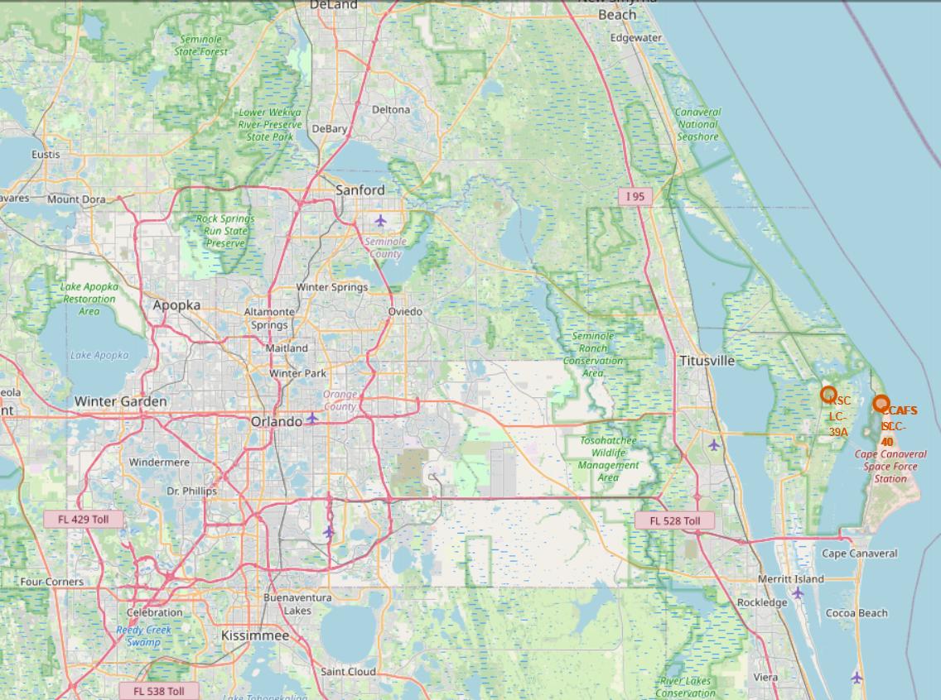
Launch Site Locations
The left map shows all launch sites relative US map.
The right map shows the two Florida launch sites since they are very close to each other. All launch sites are near the ocean.

Slide 36
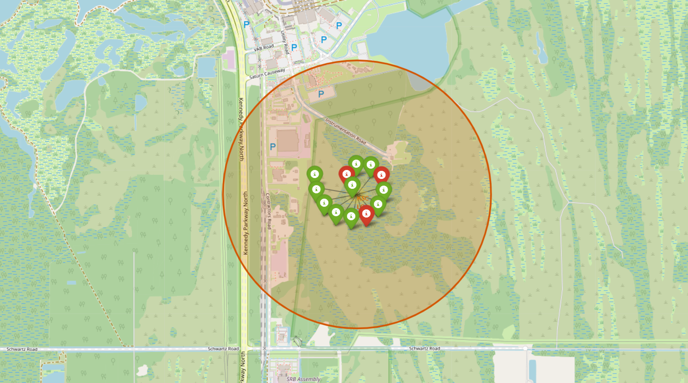
Color-Coded Launch Markers
Clusters on Folium map can be clicked on to display each successful landing (green icon) and failed
landing (red icon). In this example KSC LC-39A shows 10 successful landings and 3 failed landings.

Slide 37
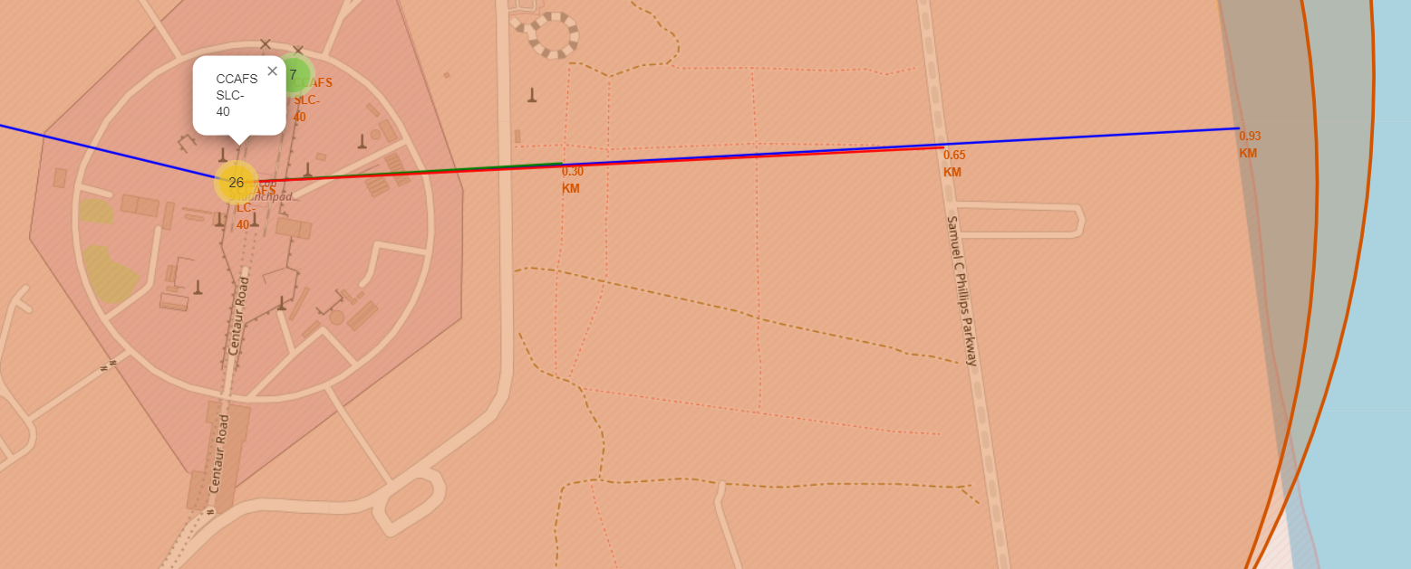
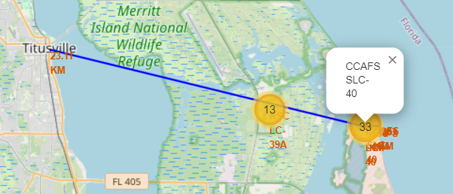
Key Location Proximities
Using CCAFS SLC-40 as an example,
Launch sites are very close to railways (0.30 Km) for large part and supply transportation.
Launch sites are close to highways (0.65 Km) for human and supply transport.
Launch sites are also close to coasts (0.93 Km) and
Relatively far from cities (23.11 Km) so that launch failures can land in the sea to avoid rockets falling on densely populated areas.

Slide 38

Section 4

Slide 39
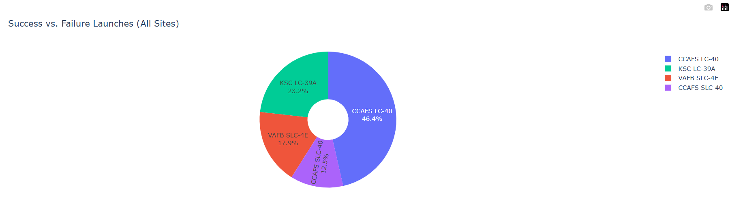
Successful Launches From across Launch Sites
This is the distribution of successful landings across all launch sites. CCAFS LC-40 is the old name of CCAFS SLC-40 so CCAFS has huge amount of successful landings, but a majority of the successful landings where performed before the name change.
VAFB has the smallest share of successful landings. This may be due to smaller sample and increase in difficulty of launching in the west coast.

Slide 40
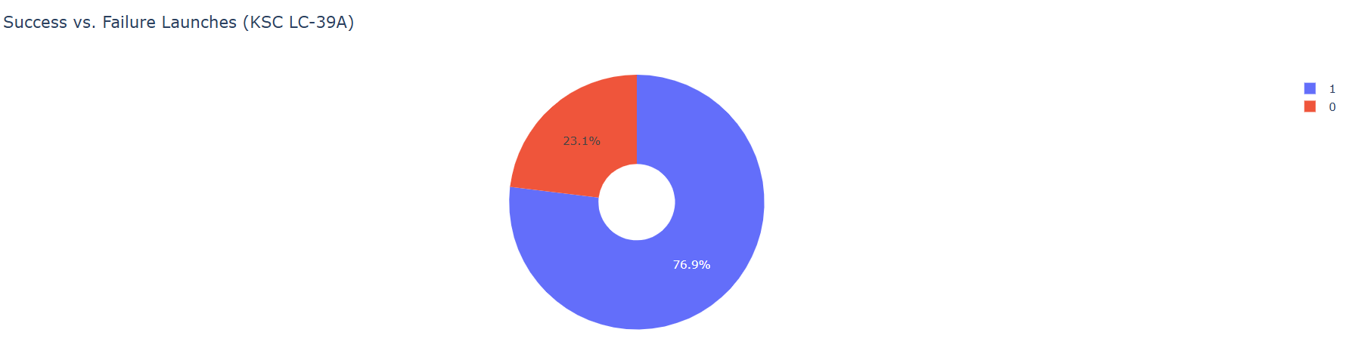
Highest Success Rate Launch Site
KSC LC-39A has the highest success rate with 10 successful landings and 3 failed landings.

Slide 41
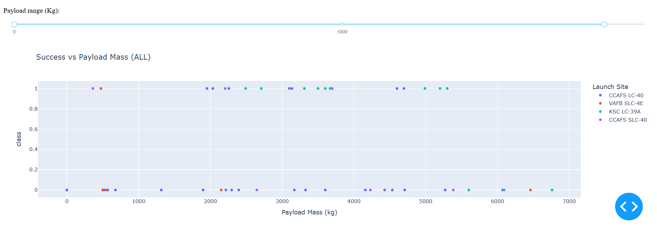
PayLoad Mass VS Success VS Booster Version cat
Plotly dashboard has a Payload range selector. However, this is set from 0-10000 instead of the max Payload of 15600. Class indicates 1 for successful landing and 0 for failure. Scatter plot also accounts for booster version category in color and number of launches in point size.

Slide 42

Section 5

Slide 43
Classification Accuracy
All models had virtually the same accuracy on the test set at 83.33% accuracy. It should be noted that test size is small at only sample size of 18.
This can cause large variance in accuracy results, such as those in Decision Tree Classifier model in repeated runs.
We likely need more data to determine the best model.

Slide 44

Confusion Matrix
Since all models performed the same for the test set, the confusion matrix is the same across all models. The models predicted 12 successful landings when the true label was successful landing.
The models predicted 3 unsuccessful landings when the true label was unsuccessful landing.
The models predicted 3 successful landings when the true label was unsuccessful landings (false positives). Our models over predict successful landings.

Slide 45
Conclusions
Our task: to develop a machine learning model for Space Y who wants to bid against SpaceX
The goal of model is to predict when Stage 1 will successfully land to save ~$100 million USD
Used data from a public SpaceX API and web scraping SpaceX Wikipedia page
Created data labels and stored data into a DB2 SQL database
Created a dashboard for visualization
We created a machine learning model with an accuracy of 83%
Allon Mask of SpaceY can use this model to predict with relatively high accuracy whether a launch will have a successful Stage 1 landing before launch to determine whether the launch should be made or not
If possible more data should be collected to better determine the best machine learning model and improve accuracy

Slide 46
Appendix
GITHUB Repo :
https://github.com/GANESH-MAHARAJ/Applied-DataScience-Capstone

Slide 47


